Slide 1

Employee Attrition
Created By Bowthiran

Slide 2
Business Problem
Increasing recruitment and training costs
Work-Life Balance Issues, Employees are leaving due to burnout, excessive workload
Lack of Career Growth, Employees quit when they don’t see clear career advancement opportunities within the company
Poor Management and Workplace Culture, Toxic work environments and ineffective leadership drive employees away

Slide 3
Current solution
Employee Engagement & Recognition – Regular feedback, rewards, and recognition programs boost job satisfaction
Flexible Work Policies – Offering remote work, hybrid models, and better work-life balance reduces burnout
Career Development Opportunities – Providing training, mentorship, and clear growth paths improves retention

Slide 4
Proposed solution
Use Machine learning to identify employees at risk of leaving and take proactive retention measures
Personalized Career Growth Plans, Implement AI-driven career development programs tailored to individual employee aspirations
Engagement Strategies, introduce training, rewards, and performance tracking to enhance motivation and job satisfaction

Slide 5
Benefit's
Lower Hiring & Training Costs. Companies can save 30-50%
Increased Productivity. Retaining employees boosts efficiency by 20-35%
Better Workplace reducing absenteeism by 15-25%
Companies with high retention rates are 50% more attractive to job seekers, improving recruitment efforts

Slide 6
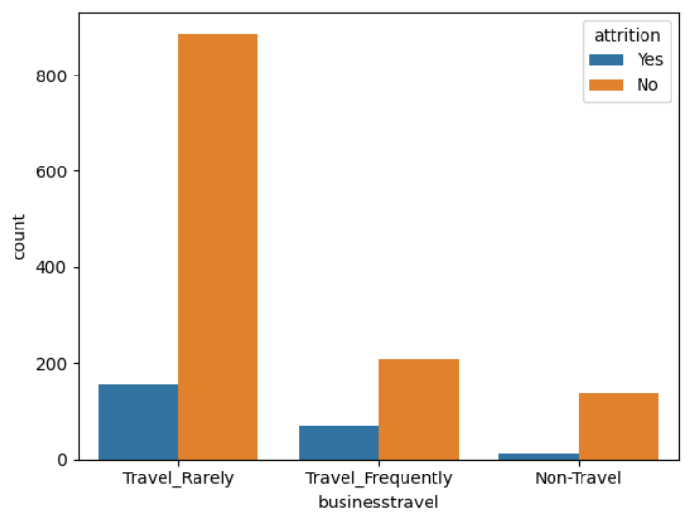
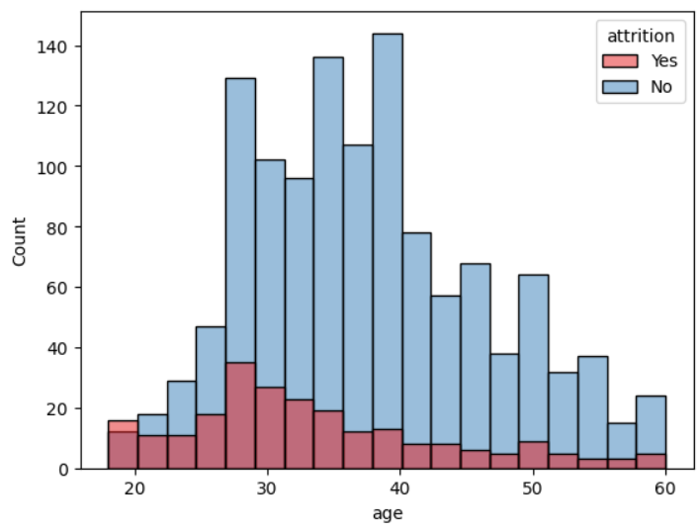
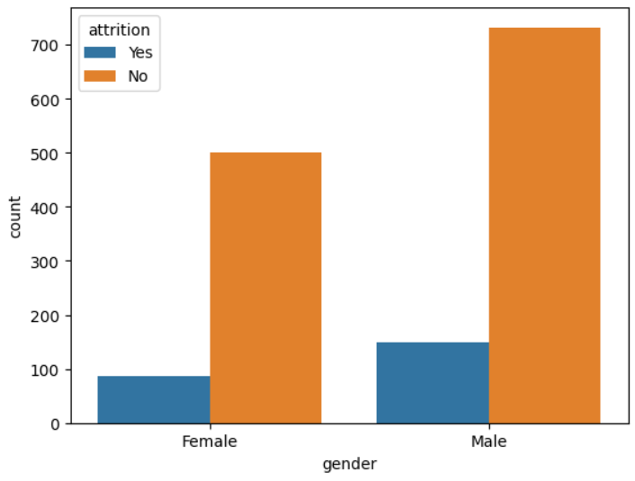
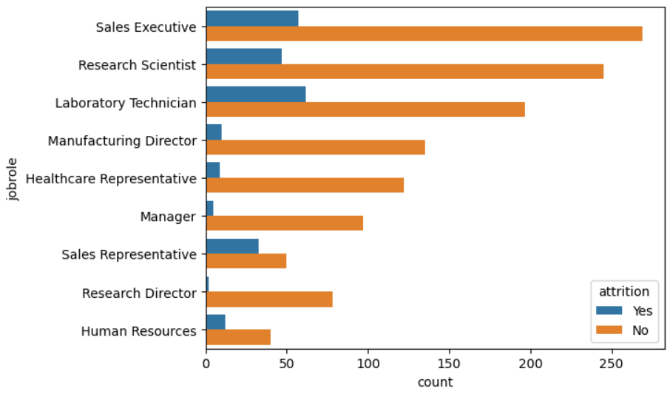

Slide 7
insights
Employees who travel rarely have the highest attrition, Employees with frequent travel also show some attrition.
Younger employees with age 25-35 show higher attrition rates, Older employees 40+ have lower attrition.
Both males and females are attrition, but males have slightly higher than female counts
Sales Executive and Laboratory Technicians and Research Scientists roles have higher attrition, Sales Representative have low compare between these three roles

Slide 8
EDA (Exploratory Data Analysis)
Drop duplicate rows to avoid bias
Data Distribution & Summary Used describe() to check mean, median, and spread of data. Visualized feature distributions using histograms & boxplots.
Correlation Analysis Used a heatmap to find relationships between features. Selected highly correlated features for model training.

Slide 9
Data Preprocessing
Label Encoding using LabelEncoder.
Outlier Detection & Treatment Used IQR Method.
Balance the dataset use smote oversampling to avoid bias and underfitting.
Feature scaling (StandardScaler)

Slide 10
Feature Selection
Selected top features based on correlation and domain important.
Model Development
Train data into 80% and 20% of data will be testing
Train models using
RandomForestClassifier

Slide 11
Model details
Key Feature’s : age, dailyrate, distancefromhome, gender, jobsatisfaction, monthlyincome, monthlyrate, overtime, percentsalaryhike, totalworkingyears, yearsatcompany.
Accuracy : 0.83
Precision : 0.80
Recall : 0.89
F1_Score : 0.84

